Slide 1

Computer Vision
Domingo Mery
History

Slide 2
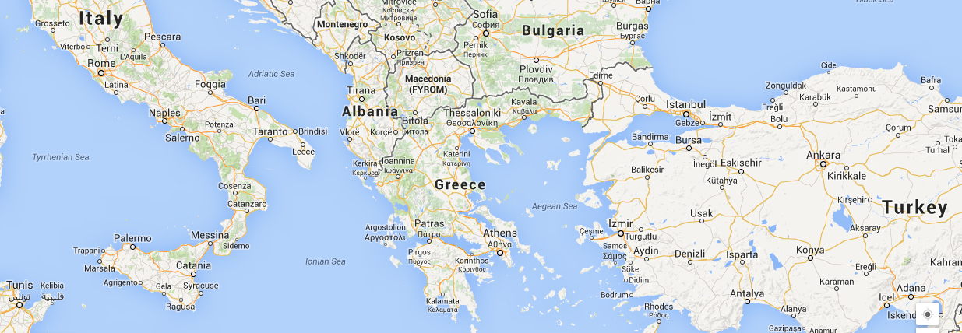
Greece, 7th – 4th century BCE

Slide 3
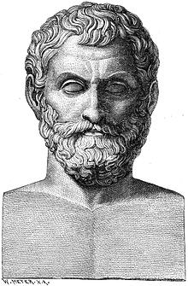
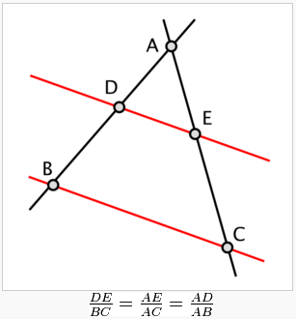
[ Greece, Thales of Miletus (c. 640 – 546 BCE) ]
Thales is credited with the Intercept Theorem, also known as Thales’ theorem or Similar Triangles Theorem:
http://en.wikipedia.org/wiki/Intercept_theorem
http://www.mathopenref.com/thales.html

Slide 4
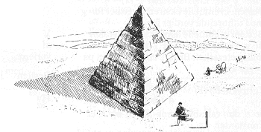
[ Greece, Thales of Miletus (c. 640 – 546 BCE) ]
http://en.wikipedia.org/wiki/Intercept_theorem
http://www.mathopenref.com/thales.html

Slide 5
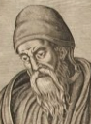
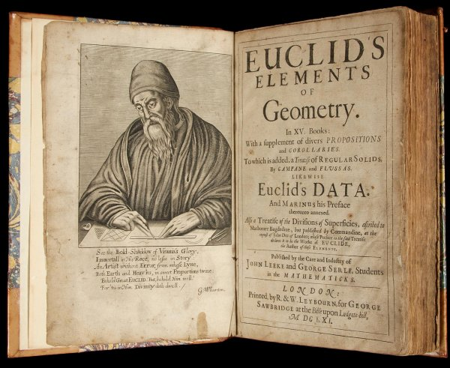
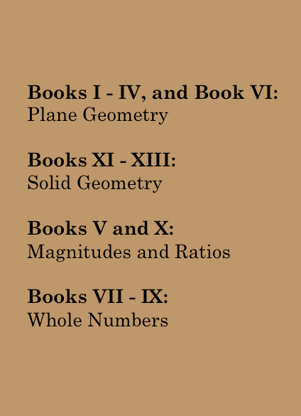
[ Greece, Euclides (c. 430 – 360 BCE) ]
https://explorable.com/euclid

Slide 6
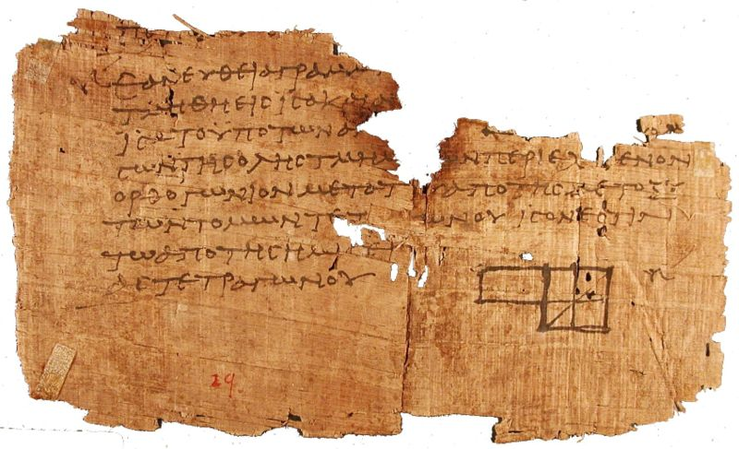
[ Greece, Euclides (c. 430 – 360 BCE) ]
Postulates:
A straight line can be drawn between any two points.
Any finite straight line can be extended indefinitely in a straight line.
For any line segment, it is possible to draw a circle using the segment as the radius and one end point as the center.
All right angles are congruent (the same).
If a straight line falling across two other straight lines results in the sum of the angles on the same side less than two right angles, then the two straight lines, if extended indefinitely, meet on the same side as the side where the angle sums are less than two right angles.
https://explorable.com/euclid

Slide 7
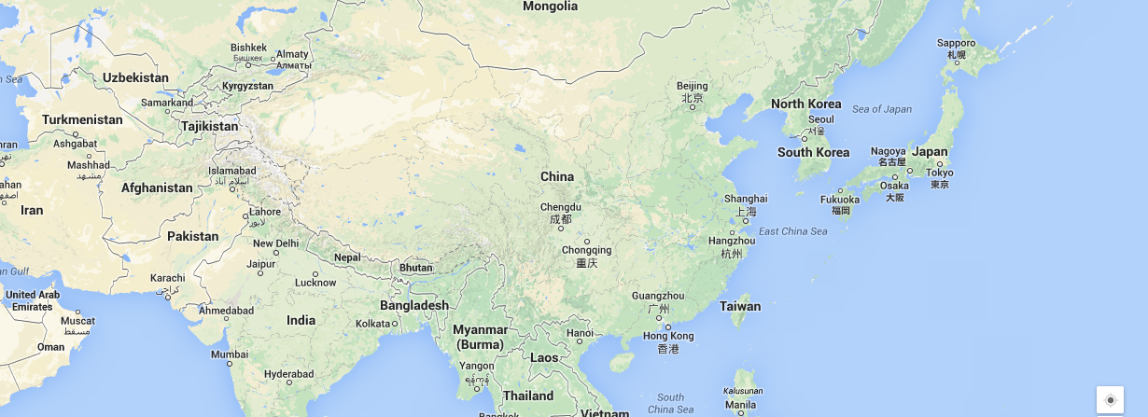
Asia, 7th – 4th century CE

Slide 8
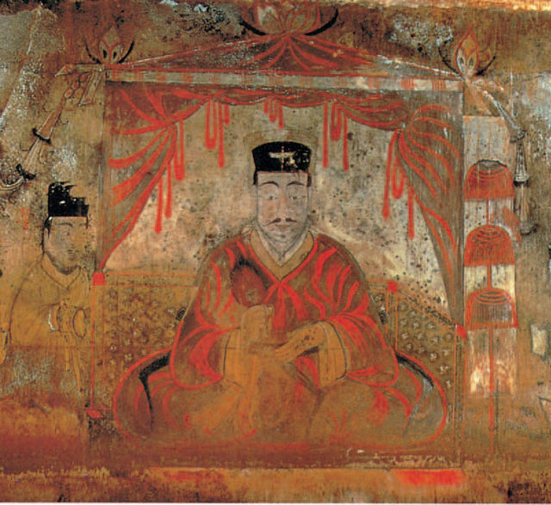
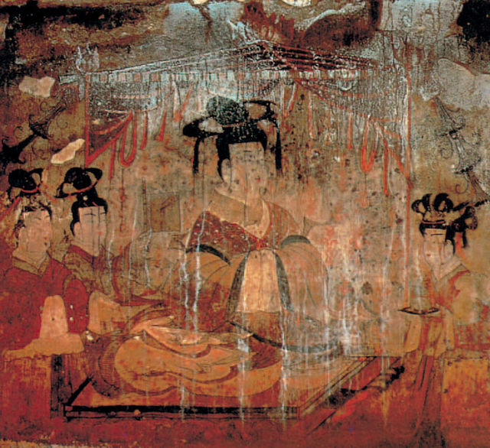
[ Korea, Frescos of Goguryeo Kingdom (4th century)]
http://commons.wikimedia.org/wiki/Category:4th-century_paintings

Slide 9
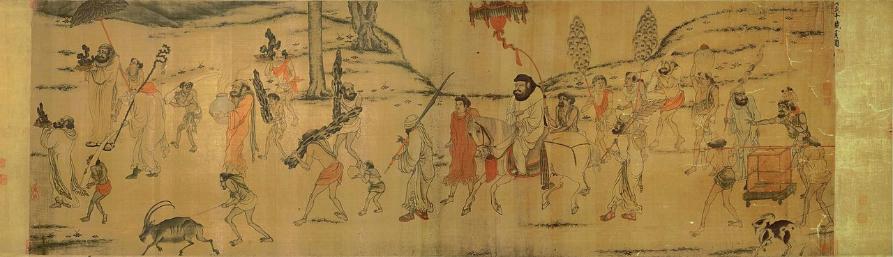
[ China, Drawings of Yan Liben (670 – 673)]
http://tech2.npm.gov.tw/english/dm/painting/b_01.htm

Slide 10
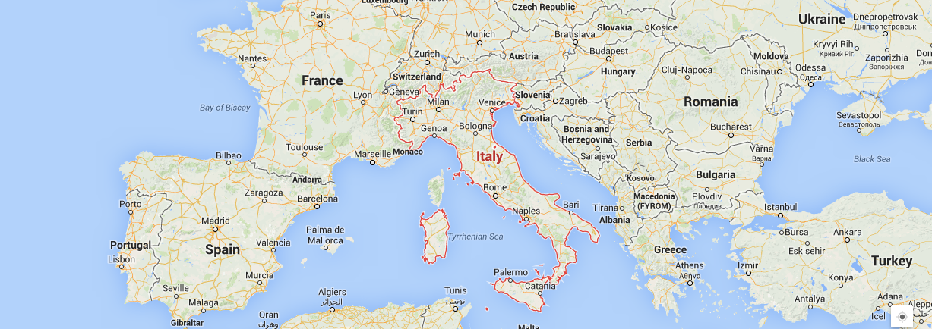
Italy, 13th – 16th century CE

Slide 11
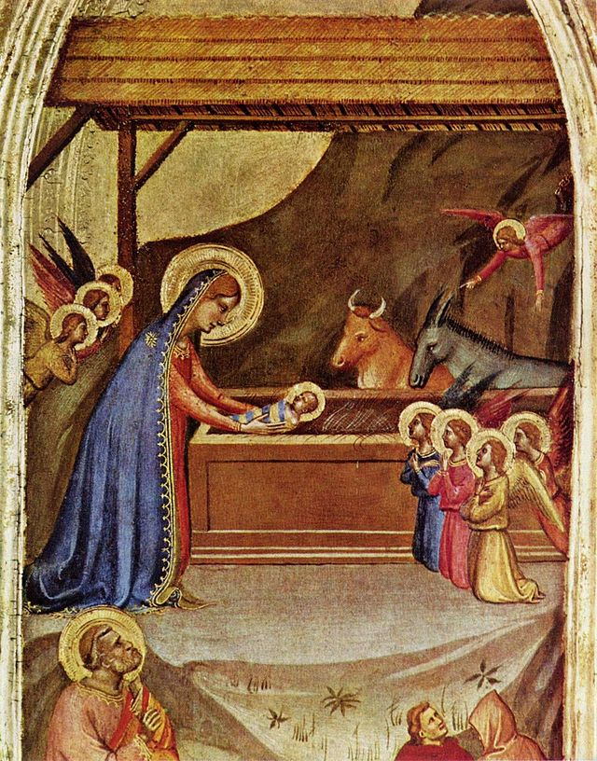
[ Italy, Bernardo Daddi (1280 – 1348) ]
http://commons.wikimedia.org/wiki/Category:Pre-Renaissance_paintings

Slide 12
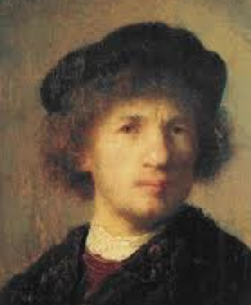

[ Italy, Filippo Bruneleschi (1377 – 1446) ]
https://www.youtube.com/watch?v=bkNMM8uiMww

Slide 13
Filippo Brunelleschi: perspective mirror

Slide 14

© Domingo Mery

Slide 15
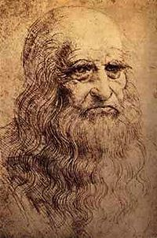
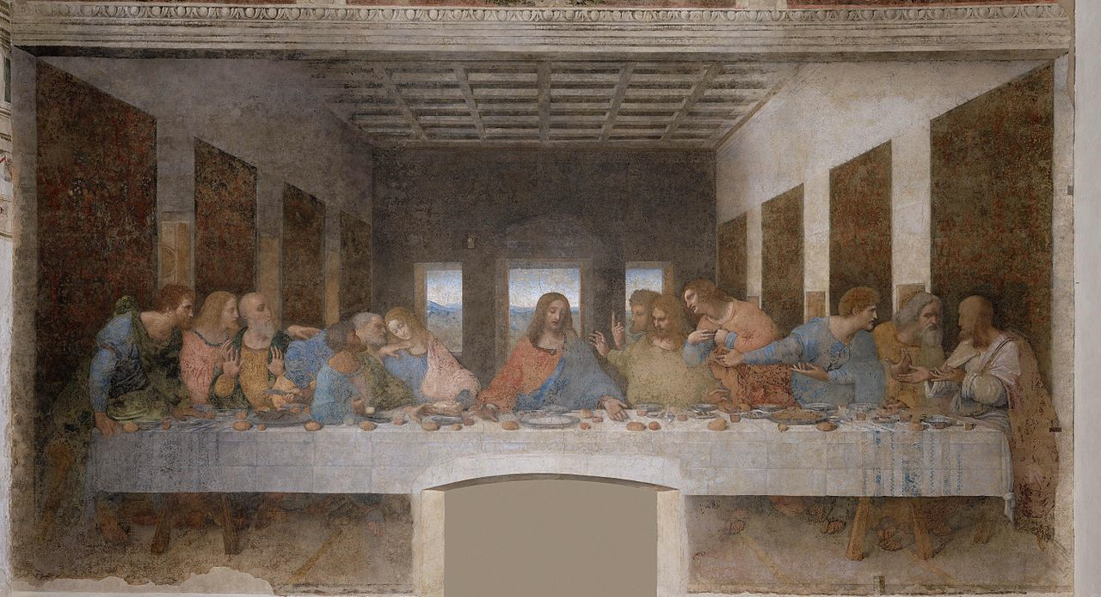
[ Leonardo da Vinci (1452 – 1519) ]
http://commons.wikimedia.org/wiki/Leonardo_da_Vinci

Slide 16
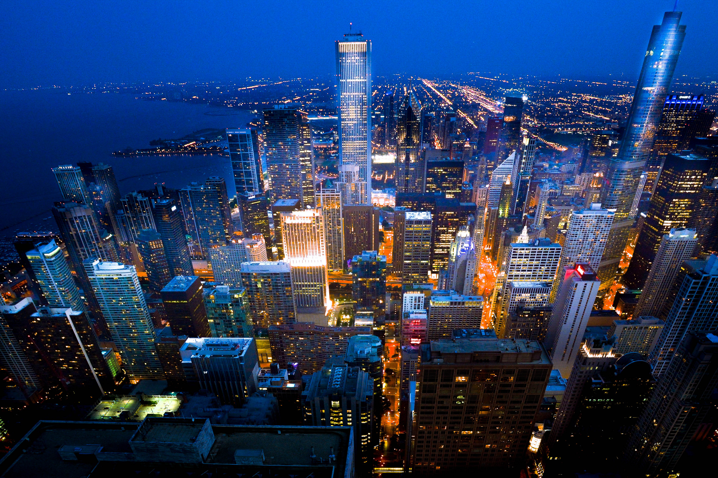
© Domingo Mery

Slide 17
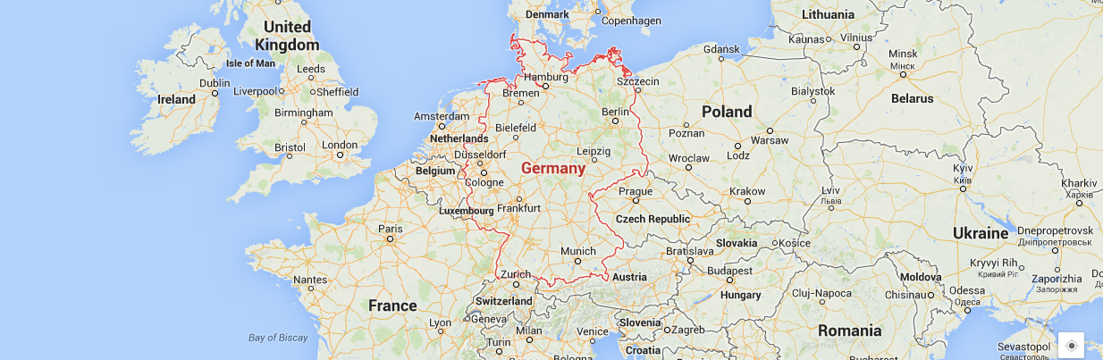
Germany, 16th century CE

Slide 18
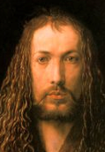
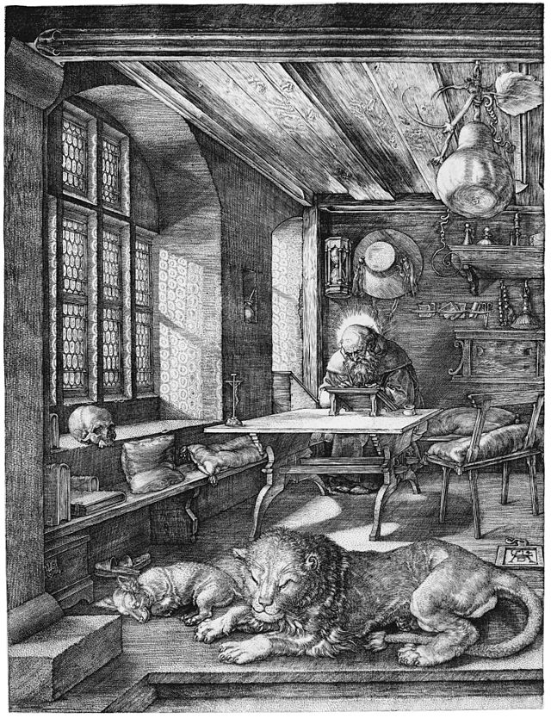
[ Albrecht Dürer (1471 – 1528) ]
http://commons.wikimedia.org/wiki/Albrecht_Dürer

Slide 19
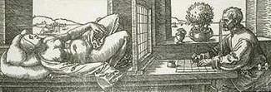
[ Albrecht Dürer (1471 – 1528) ]
Perspective Machine by Albrecht Dürer
http://commons.wikimedia.org/wiki/Albrecht_Dürer

Slide 20
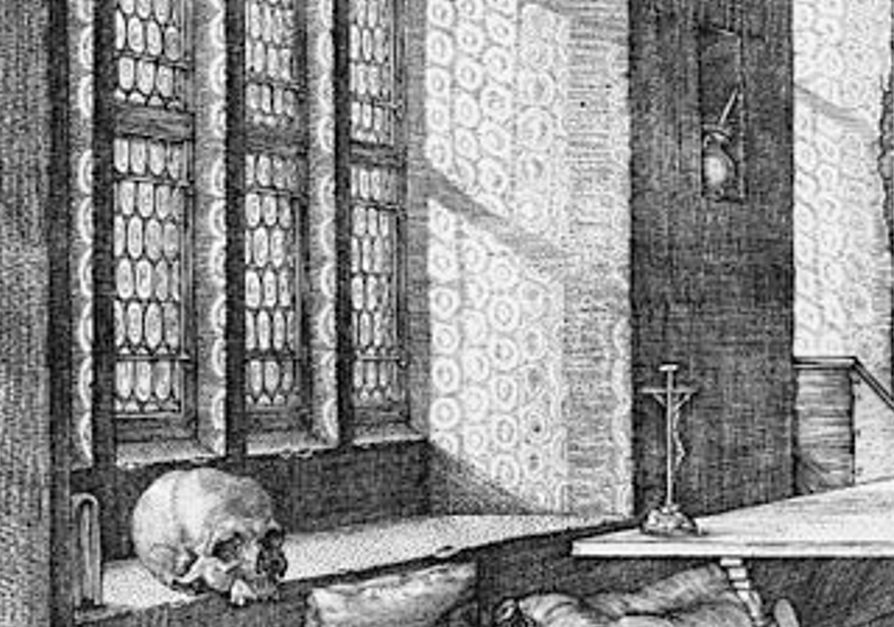
[ Albrecht Dürer (1471 – 1528) ]
Perspective Machine by Albrecht Dürer
http://commons.wikimedia.org/wiki/Albrecht_Dürer

Slide 21
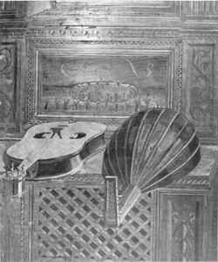
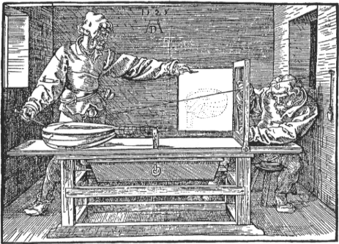
[ Albrecht Dürer (1471 – 1528) ]
Perspective Machine by Albrecht Dürer
http://commons.wikimedia.org/wiki/Albrecht_Dürer

Slide 22
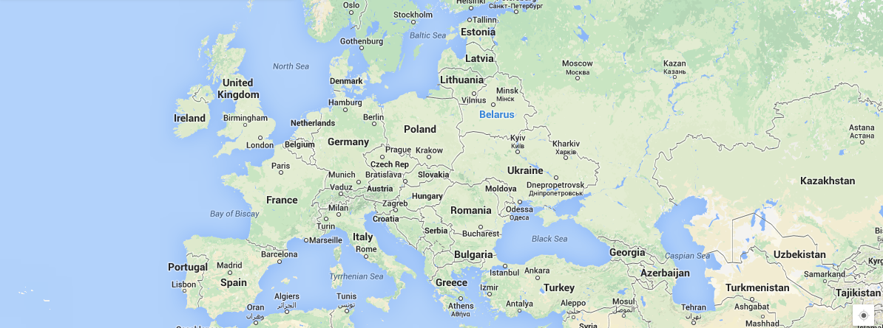
Europe, 16th century CE

Slide 23
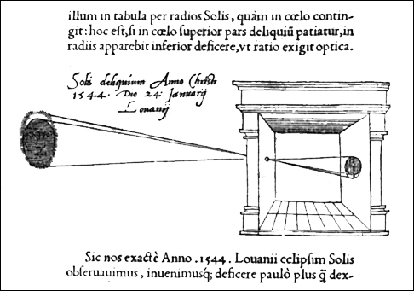
[ Gemma Frisius: 1545 Camera Obscura (darkened room)]
http://www.pinhole.cz/en/pinholecameras/whatis.html

Slide 24
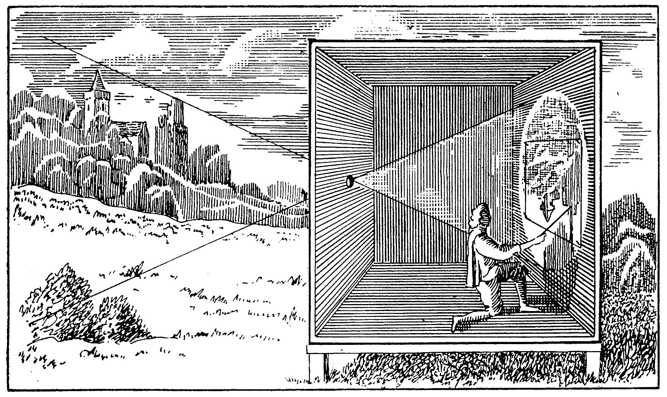
[ Camera Obscura in paintings ]
http://akvis.com/en/articles/photo-history/beginning.php

Slide 25

[ Camera Obscura ]
https://www.youtube.com/watch?v=yvWX6-0_VHU

Slide 26
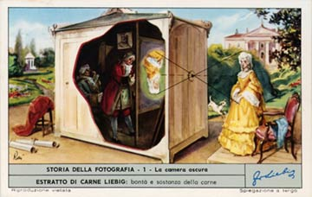
[ 18-19th century: Trade Cards with Camera Obscura ]
http://brightbytes.com/cosite/tradecards.html

